Slide 1
Group 12
Wenjing Ye
Jiayu Xue
20241118 Gao Si Li Chen Capturing the Baijiu Industry Landscape.key

Slide 2
import requests
from bs4 import BeautifulSoup
import csv
from datetime import datetime
import re
def scrape_china_daily():
# 设置请求头模拟浏览器访问
headers = {
'User-Agent': 'Mozilla/5.0 (Windows NT 10.0; Win64; x64) AppleWebKit/537.36 (KHTML, like Gecko) Chrome/91.0.4472.124 Safari/537.36'
}
# 发送HTTP请求
url = 'https://www.chinadaily.com.cn/china/governmentandpolicy'
try:
response = requests.get(url, headers=headers, timeout=10)
response.raise_for_status() # 检查请求是否成功
except requests.exceptions.RequestException as e:
print(f"请求失败: {e}")
return
# 使用BeautifulSoup解析HTML
soup = BeautifulSoup(response.text, 'html.parser')
# 存储结果的列表
news_list = []
# 提取新闻条目 - 根据实际页面结构调整选择器
# 示例选择器可能需要根据网站更新调整
news_items = soup.select('.mb10.tw3_01_2, .topNews')
for item in news_items:
try:
# 提取标题
title_tag = item.select_one('h4 a, h3 a, h2 a')
if not title_tag:
continue
title = title_tag.get_text().strip()
# 提取链接
relative_url = title_tag.get('href')
if relative_url.startswith('//'):
full_url = 'https:' + relative_url
elif relative_url.startswith('/'):
full_url = 'https://www.chinadaily.com.cn' + relative_url
else:
full_url = relative_url
# 提取日期
date_tag = item.select_one('.date')
if date_tag:
date_str = date_tag.get_text().strip()
else:
# 如果没有日期标签，使用当前日期
date_str = datetime.now().strftime('%Y-%m-%d')
# 清理日期格式 (处理多种日期格式)
date_match = re.search(r'\d{4}-\d{2}-\d{2}', date_str)
if date_match:
clean_date = date_match.group(0)
else:
clean_date = date_str.split()[0] # 取第一个单词作为日期
# 添加到结果列表
news_list.append({
'title': title,
'date': clean_date,
'url': full_url
})
except Exception as e:
print(f"处理条目时出错: {e}")
continue
# 保存到CSV文件
if news_list:
filename = f"china_daily_news_{datetime.now().strftime('%Y%m%d')}.csv"
with open(filename, 'w', newline='', encoding='utf-8-sig') as csvfile:
fieldnames = ['title', 'date', 'url']
writer = csv.DictWriter(csvfile, fieldnames=fieldnames)
writer.writeheader()
for news in news_list:
writer.writerow(news)
print(f"成功提取 {len(news_list)} 条新闻，已保存到 {filename}")
else:
print("未提取到任何新闻数据")
if __name__ == '__main__':
scrape_china_daily()

Slide 4
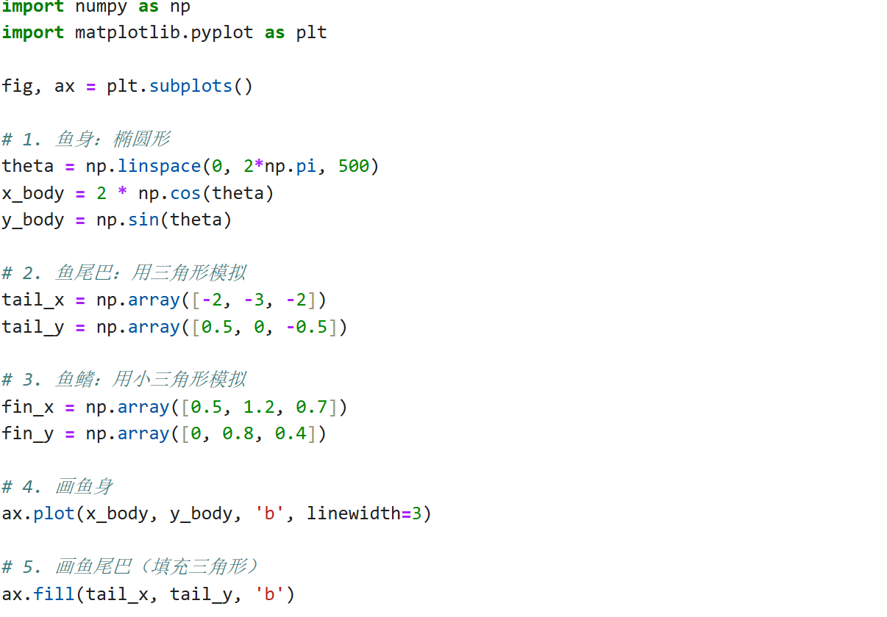
fish

Slide 5
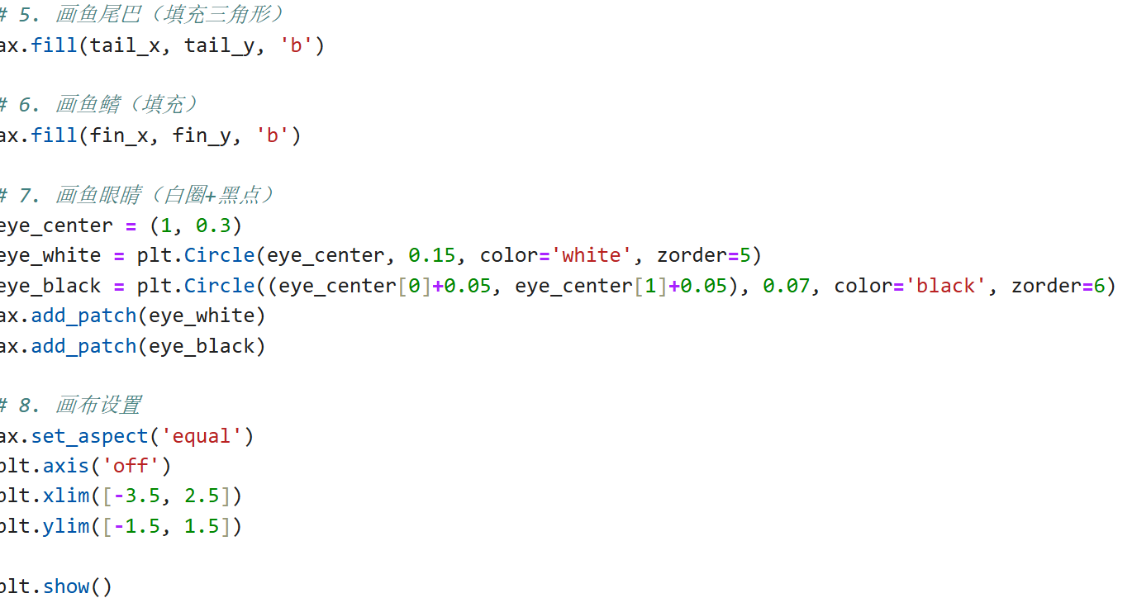
fish

Slide 6



Digital Economy
Motivation
2cos(t)-1.2cos(2t)+0.6cos(3t)-0.8cos(4t),0.8sin(2t)=1.5sin(3t)-0.5sin(4t)

Slide 7
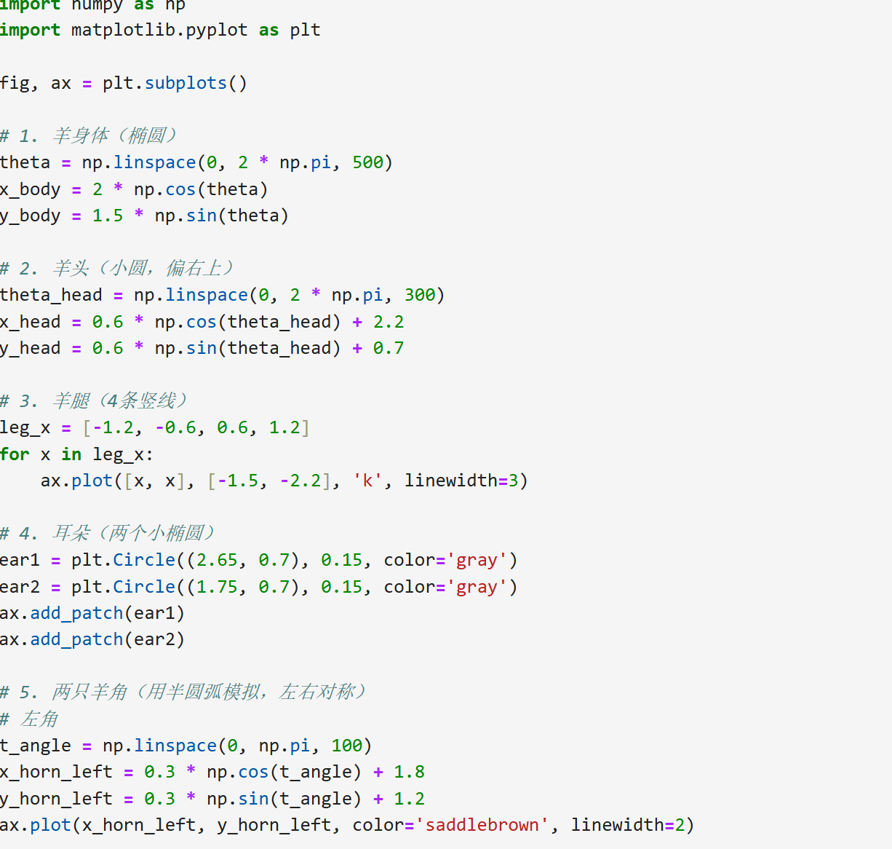

Slide 8
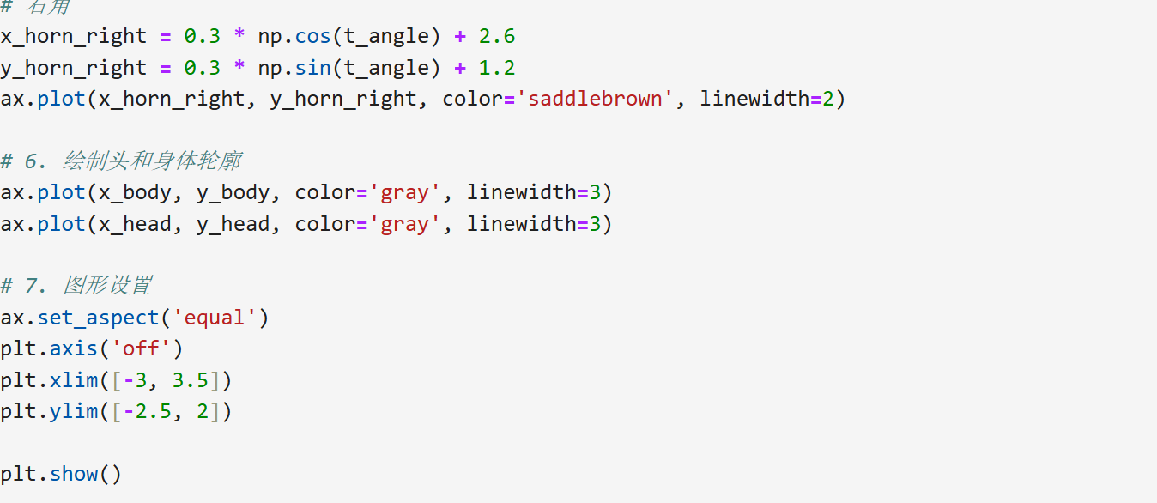


Slide 9
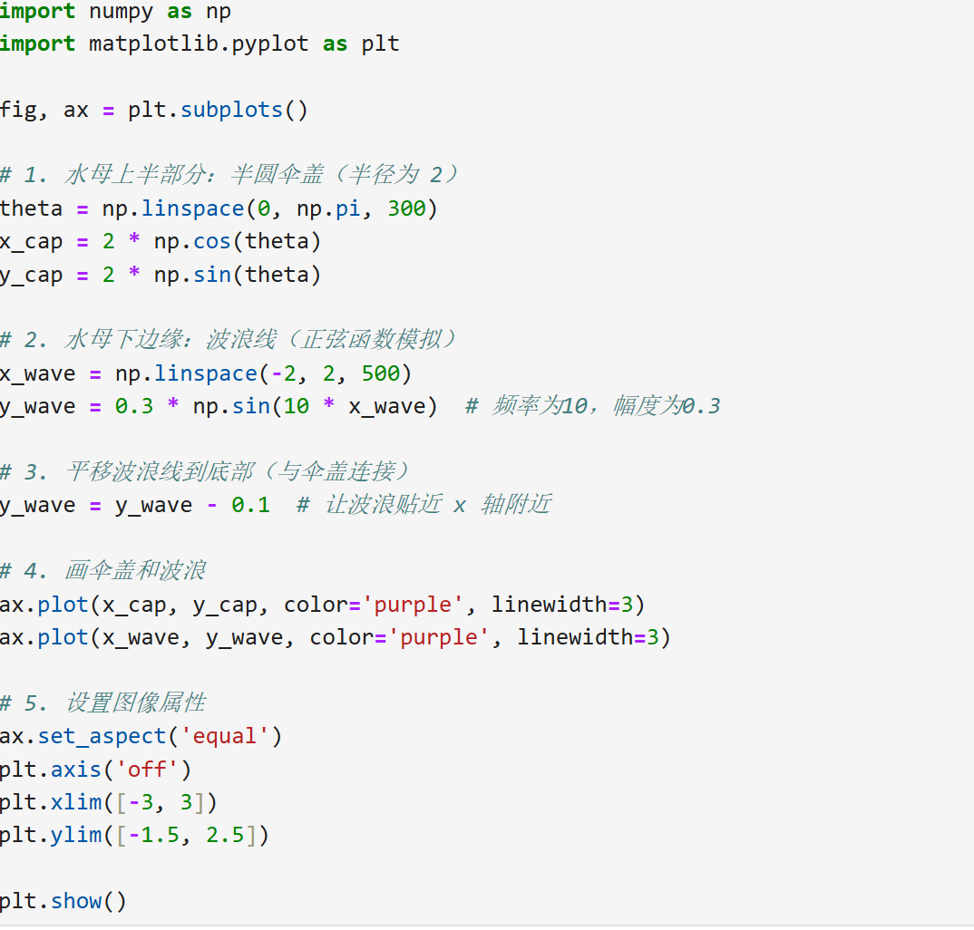

Slide 10


Slide 11
The 2nd homework
scrape the south CN morning post

Slide 12
South CN morning post scrape
Homework 2
import requests
from bs4 import BeautifulSoup
import csv
from datetime import datetime
import re
def scrape_china_daily():
# 设置请求头模拟浏览器访问
headers = {
'User-Agent': 'Mozilla/5.0 (Windows NT 10.0; Win64; x64) AppleWebKit/537.36 (KHTML, like Gecko) Chrome/91.0.4472.124 Safari/537.36'
}
# 发送HTTP请求
url = 'https://www.chinadaily.com.cn/china/governmentandpolicy'
try:
response = requests.get(url, headers=headers, timeout=10)
response.raise_for_status() # 检查请求是否成功
except requests.exceptions.RequestException as e:
print(f"请求失败: {e}")
return

Slide 13
South CN morning post scrape
Homework 2
# 使用BeautifulSoup解析HTML
soup = BeautifulSoup(response.text, 'html.parser')
# 存储结果的列表
news_list = []
# 提取新闻条目 - 根据实际页面结构调整选择器
# 示例选择器可能需要根据网站更新调整
news_items = soup.select('.mb10.tw3_01_2, .topNews')
for item in news_items:
try:
# 提取标题
title_tag = item.select_one('h4 a, h3 a, h2 a')
if not title_tag:
continue
title = title_tag.get_text().strip()
# 提取链接
relative_url = title_tag.get('href')
if relative_url.startswith('//'):
full_url = 'https:' + relative_url
elif relative_url.startswith('/'):
full_url = 'https://www.chinadaily.com.cn' + relative_url
else:
full_url = relative_url

Slide 14
South CN morning post scrape
Homework 2
# 提取日期
date_tag = item.select_one('.date')
if date_tag:
date_str = date_tag.get_text().strip()
else:
# 如果没有日期标签，使用当前日期
date_str = datetime.now().strftime('%Y-%m-%d')
# 清理日期格式 (处理多种日期格式)
date_match = re.search(r'\d{4}-\d{2}-\d{2}', date_str)
if date_match:
clean_date = date_match.group(0)
else:
clean_date = date_str.split()[0] # 取第一个单词作为日期
# 添加到结果列表
news_list.append({
'title': title,
'date': clean_date,
'url': full_url
})
except Exception as e:
print(f"处理条目时出错: {e}")
continue

Slide 15
South CN morning post scrape
Homework 2
# 保存到CSV文件
if news_list:
filename = f"china_daily_news_{datetime.now().strftime('%Y%m%d')}.csv"
with open(filename, 'w', newline='', encoding='utf-8-sig') as csvfile:
fieldnames = ['title', 'date', 'url']
writer = csv.DictWriter(csvfile, fieldnames=fieldnames)
writer.writeheader()
for news in news_list:
writer.writerow(news)
print(f"成功提取 {len(news_list)} 条新闻，已保存到 {filename}")
else:
print("未提取到任何新闻数据")
if __name__ == '__main__':
scrape_china_daily()
成功提取 20 条新闻，已保存到 china_daily_news_20250709.csv

